Slide 1
LIP-READ DETECTION USING DEEP LEARNING
By Deepshikha Mahato

Slide 2

Why do we need Lip- Read Detection?
Accurate visual speech recognition.
Improving accessibility.
Enhancing communication in noisy environments.
Advancing human-computer interaction.

Slide 3
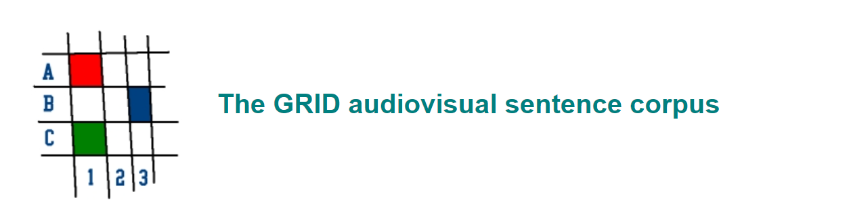
Dataset Collection
Dataset Used:-
GRID is a large multitalker audiovisual sentence corpus to support joint computational-behavioral studies in speech perception.
The corpus consists of high-quality audio and video (facial) recordings of 1000 sentences spoken by each of 34 talkers (18 male, 16 female).
For this project, only One Male speaker video having 1000 short video files with respective annotations is used for test cases.
Sentences are of the form "put red at G9 now".

Slide 4
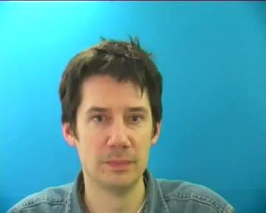
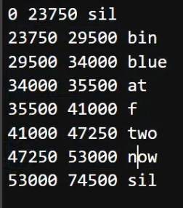

Data Preprocessing:-
Fetches a batch of video frames and corresponding text alignments from the dataset, setting them up for the model to process, make predictions and, compute the loss function.

Slide 5
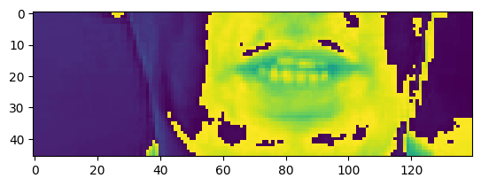
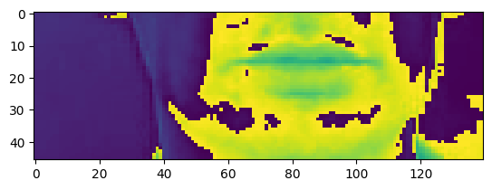
Checking whether the frames are correct or not?
Frames 40
Frames 50

Slide 6

Data Pipeline
Creating a tensorflow dataset.
Taking 75 frames in a video.
We take the greyscale video frames after padding and change it to a gif file by using the function image.io.
This is the what LipNet model takes to decode, what it’s trying to say.

Slide 7
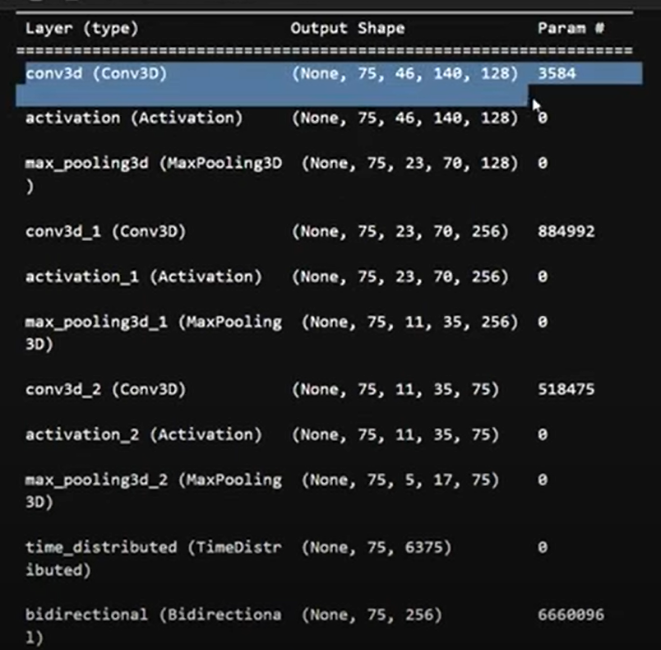
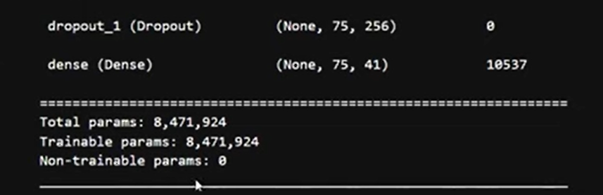
SEQUENTIAL MODEL USED:-
Used sequential model.
Layers used COV3D, LSTM, Dense, Dropout.
Callbacks – ModelCheckpoint at 50 and 96, LearningRateScheduler.
Network:
Sequential layer
3 sets of Convolutional layers, with different sets of kernels (128, 256, 75) respectively
2 sets of LSTM
Dense layer

Slide 8
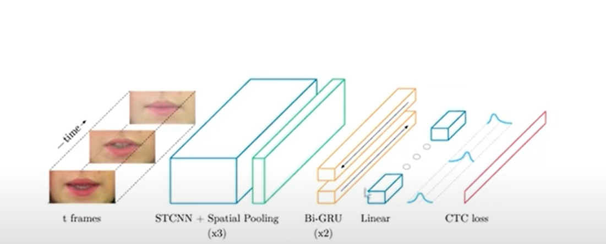
SIMILAR MODEL IMPLEMENTATION
Comparison:-
We use a sequential model, whereas, they used Special CNN model.
We use Bi-directional ,rest is the same whereas, they used Bi-GRU.

Slide 9
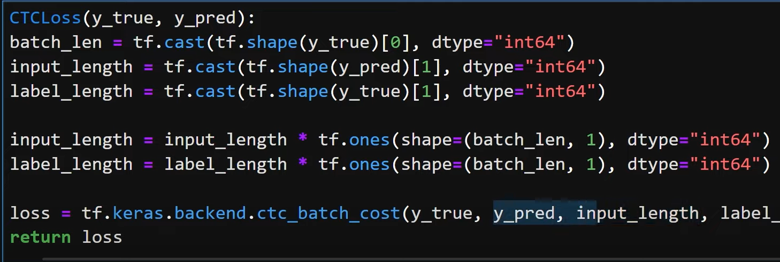
CTC LOSS FUNCTION (Connectionist Temporal Classification)
Managing sequence alignment,
Variable lengths.
Blank labels.
Enabling streamlined, end-to-end training directly from visual speech input to text output.

Slide 10
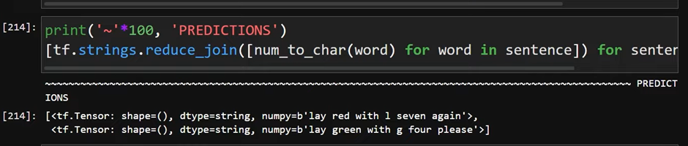
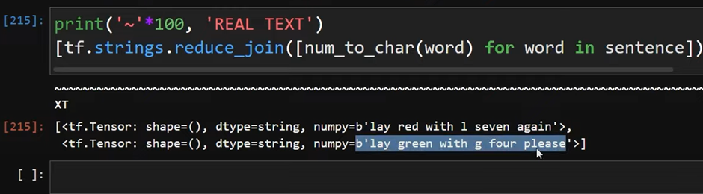
PREDICTIONS ON SAMPLE TEXT
PREDICTIONS ON REAL TEXT

Slide 11
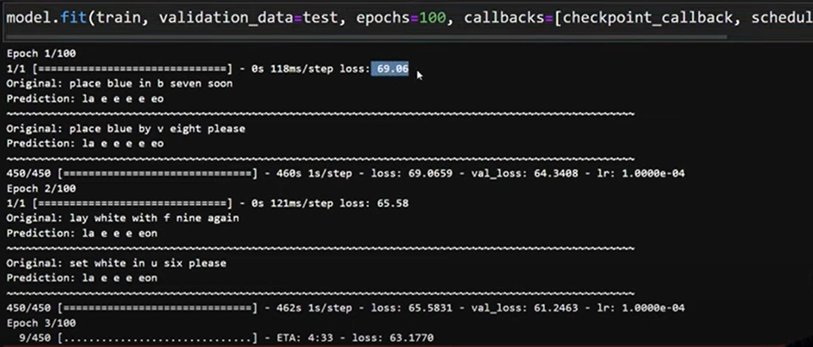
TRAINING STEP (UPTO 100 EPOCHS)

Slide 12
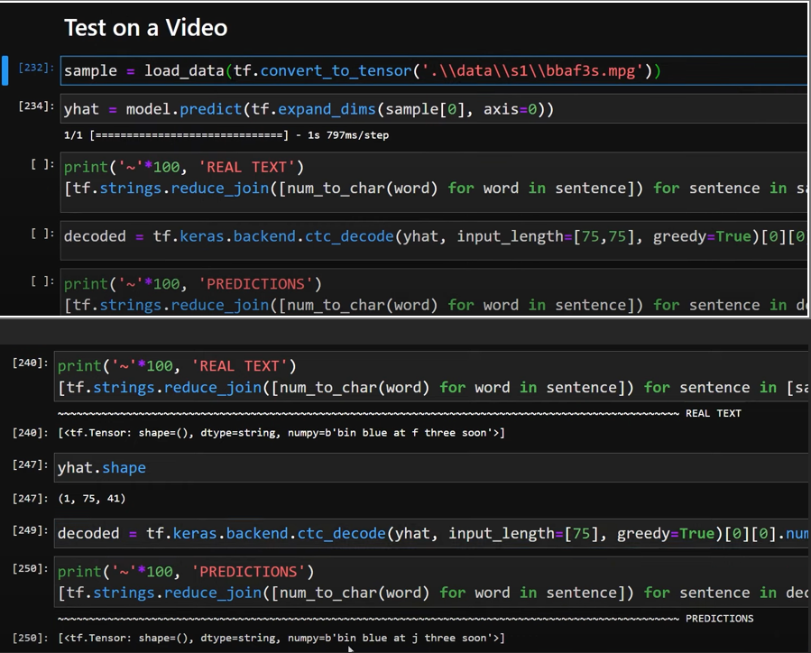
TESTING ON A SAMPLE VIDEO
The prediction is from loading a video, and prediction is almost the same
real text – bin blue at f three soon | predicted text – bin blue at j three soon.

Slide 13
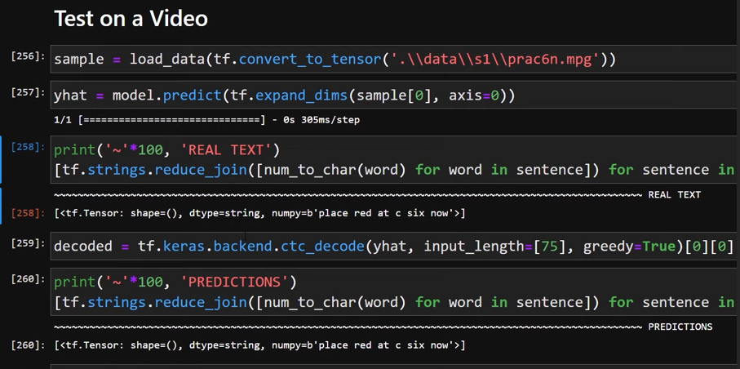
TESTING ON SECOND VIDEO

Slide 14
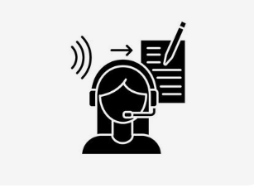
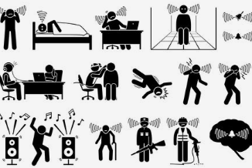
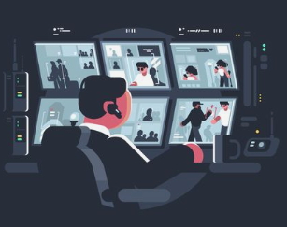
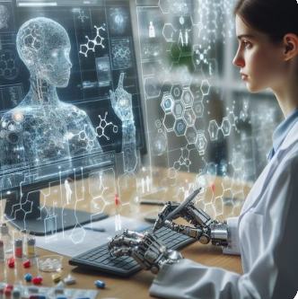


FUTURE SCOPE
Enhanced Accessibility for people hearing impairments.
Enhancing voice-activated systems and virtual assistants in noisy environments
Enhancing security measures in high-security areas and public spaces.
Human-Computer Interaction: Allowing visual speech commands for navigating devices, AR, VR, and smart home technologies.
Facilitate communication between doctors and patients, particularly for those with health conditions affecting verbal communication.
Enhancing pronunciation and communication skills, leading to more effective language learning.

Slide 15
References :-
Assael, Y. M., Shillingford, B., Whiteson, S., & de Freitas, N. (2016). LipNet: End-to-End Sentence-level Lipreading. arXiv preprint arXiv:1611.01599.
Arakane, T., & Saitoh, T. (2023). Efficient DNN Model for Word Lip-Reading. Algorithms, 16(6), 269. https://doi.org/10.3390/a16060269.

Slide 16
Thank You!

